Slide 1
Phase 1
Creating scPRINT_net, pyscenic_net, and peturb_net

Slide 2
Why?
pySCENIC-net (co-expression + motif based method)
Infers TF => target edges, baseline
scPRINT (attention-weight based)
The model is pretrained on millions of cells and learned gene-gene relationship
Uses transformer attention weights to score how strongly each gene “attends to “each other”

Slide 3
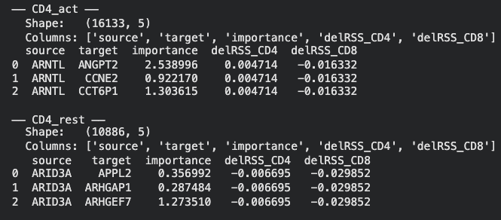
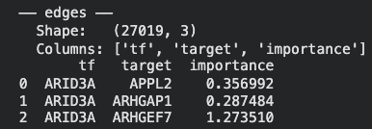
scenic-net (5 files)

Slide 4
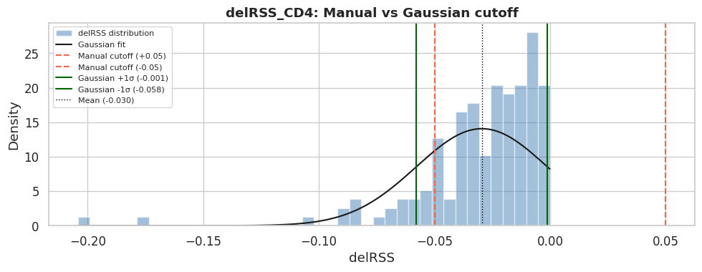
scenic-net (5 files)

Slide 5
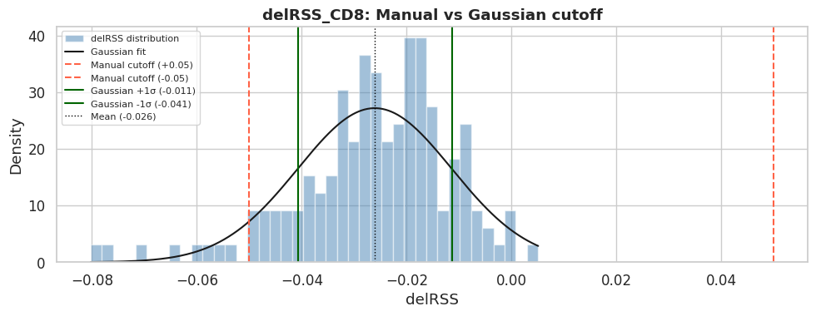
scenic-net (5 files)

Slide 6
Scenic-net (filtered) (8 files)
For each cell state (CD4_act, CD4_rest, CD8_act, CD8_rest), we filtered the pySCENIC edge network:
to retain only TFs that showed meaningful state-specificity based on their Regulon Specificity Score delta (delRSS = RSS_act − RSS_rest).
Two cutoff strategies were applied: a manual cutoff of |delRSS| > 0.05 (as suggested by the PI), and a data-driven Gaussian cutoff using mean ± 1σ of the delRSS distribution per lineage.
For activation states, TFs with delRSS above the positive cutoff were retained; for resting states, TFs with delRSS below the negative cutoff were retained. This produced 8 filtered networks (4 states × 2 cutoffs) representing the candidate state-specific regulatory programs.

Slide 7
scprint-net
Methodology in scprint_grn_clean.ipynb
Build genelist with scanpy differential expression
Align data to model
GRN inference
Extract edges
CD4_rest_grn_scanpy_de.h5ad — raw attention matrix for CD4 resting
CD4_act_grn_scanpy_de.h5ad — raw attention matrix for CD4 activated
CD8_rest_grn_scanpy_de.h5ad — same for CD8
CD8_act_grn_scanpy_de.h5ad — same for CD8
{state}_scprint_scanpy_de_edges.csv — flat edge list per state
all_states_scprint_scanpy_de_edges.csv — all four combined

Slide 8
scprint-net
Methodology in scprint_grn_clean.ipynb
Build genelist with scanpy differential expression
Align data to model
GRN inference
Extract edges
CD4_rest_grn_scanpy_de.h5ad — raw attention matrix for CD4 resting
CD4_act_grn_scanpy_de.h5ad — raw attention matrix for CD4 activated
CD8_rest_grn_scanpy_de.h5ad — same for CD8
CD8_act_grn_scanpy_de.h5ad — same for CD8
{state}_scprint_scanpy_de_edges.csv — flat edge list per state
all_states_scprint_scanpy_de_edges.csv — all four combined

Slide 9
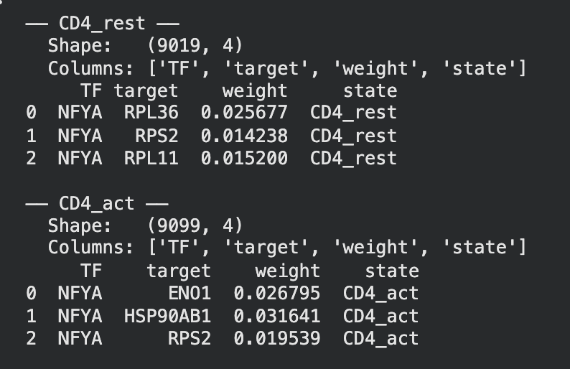
scprint-net

Slide 10
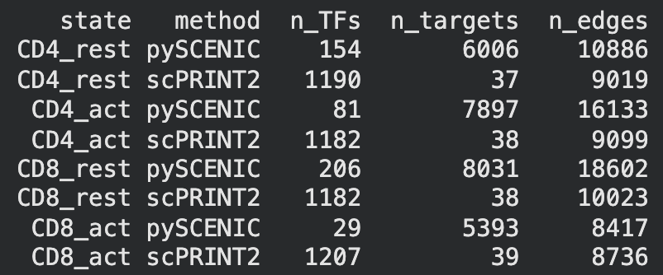
Grn vs pyscenic

Slide 11
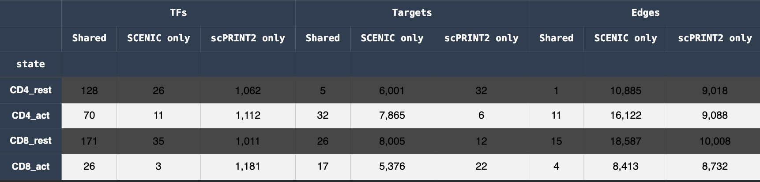
Grn vs pyscenic

